Slide 1

ATSD Ticket Automation
CIS 4850 – Information Systems Project
Project Manager
Advisor
Patrick Masterson
Dr. Jeff Kaleta
Team Members
Sponsors
Hank McAlister, Vedant Sheth, Matt Roehm
Justin Cervero & Choya Durham, ATSD

Slide 2



How Our Project Changed
Original: BarHub Mobile App
What We Realized
Strategic Decision
Boone nightlife discovery app with live specials, events, social features
Critical constraints threatened success
Pivot to deliver real business value
Focus on achievable scope
Complete mobile frontend & backend
Too large for one semester
Maintain quality standards
No mobile app production experience
Demonstrate project maturity
Instagram & mapping integrations
Risk of rushed, inferior product
Ambitious but challenging scope

Slide 3
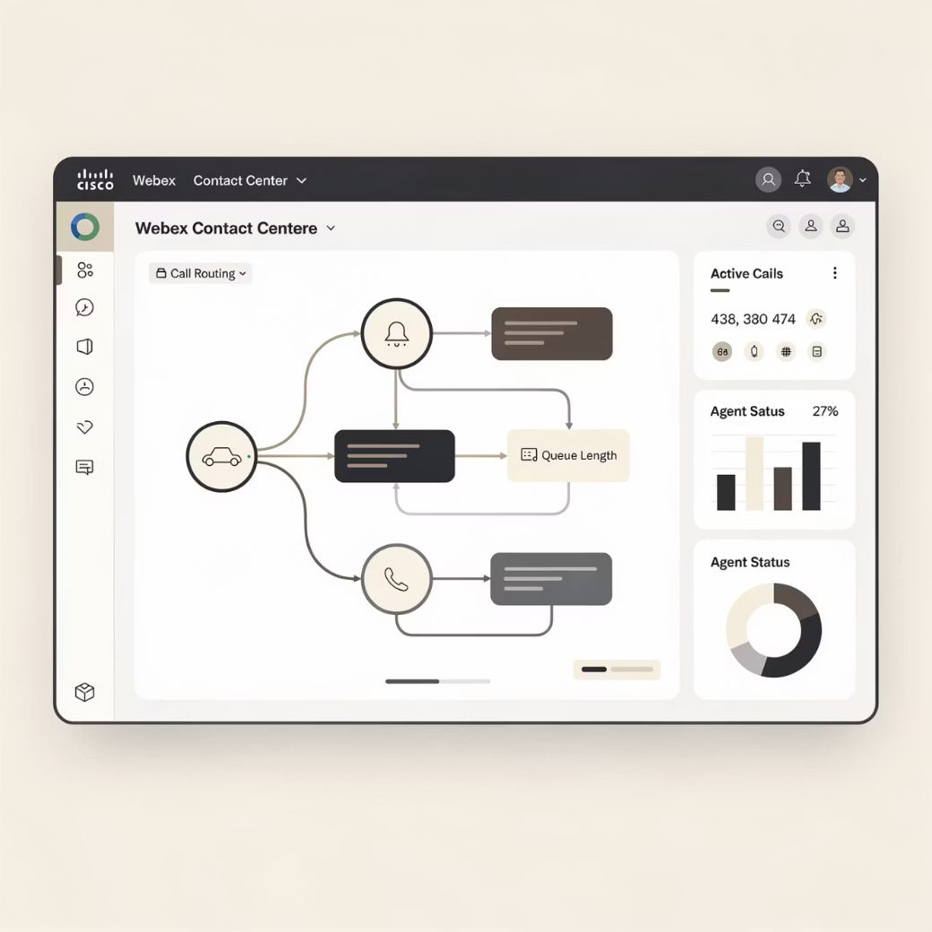

New Project: ATSD Ticket Automation
Why This Made More Sense
Clear, real-world business problem
ATSD needs consistent ticket data for audits
Strong API support: Webex flows, Cloudflare Worker, Jira REST
Achievable scope with high quality
Production-ready for campus stakeholder
Result: Smaller scope, higher quality, measurable business value
Project Focus
Integration between Cisco Webex Contact Center and Jira Service Management
Auto-creates support tickets from incoming calls

Slide 4
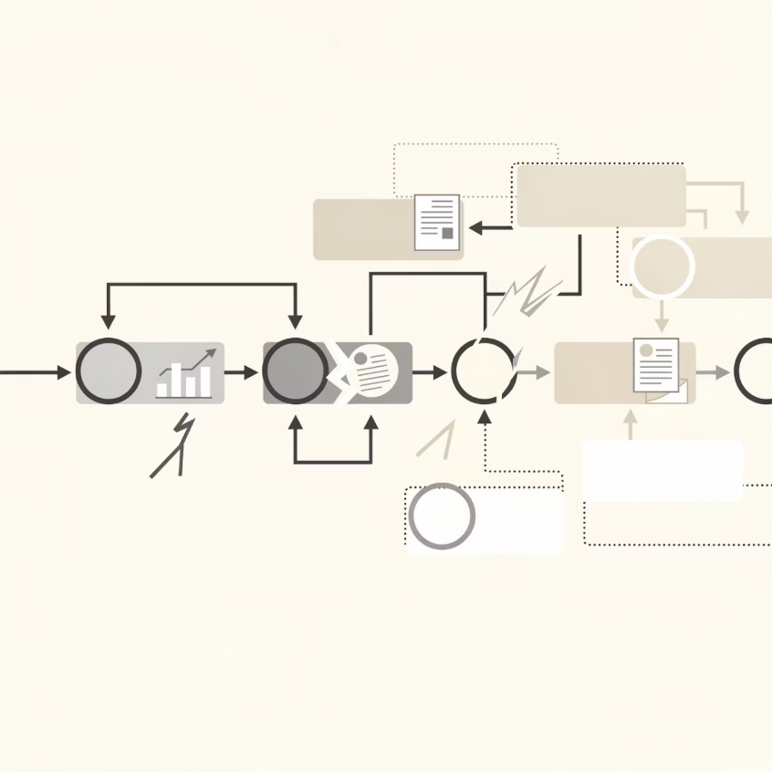
What's Broken?
Current Process Failures
Operators often don't log any ticket for calls
Manual Jira entry when tickets are created
Delays and inconsistencies
Audit Findings
Prior audit revealed: no data collection process existed, records not kept systematically
Impossible Tracking
Slower Response
Can't reliably track issues or review past interactions
Manual processes lead to delays in resolving issues
Inconsistent Data
Extra Workload
Quality and completeness vary significantly
Time on admin tasks vs. solving problems

Slide 5
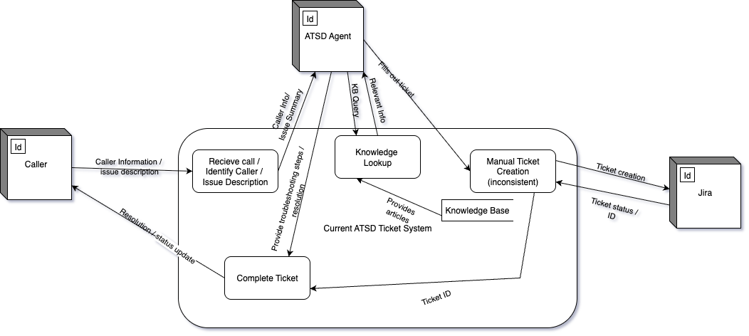
Current System: Level 0

Slide 6
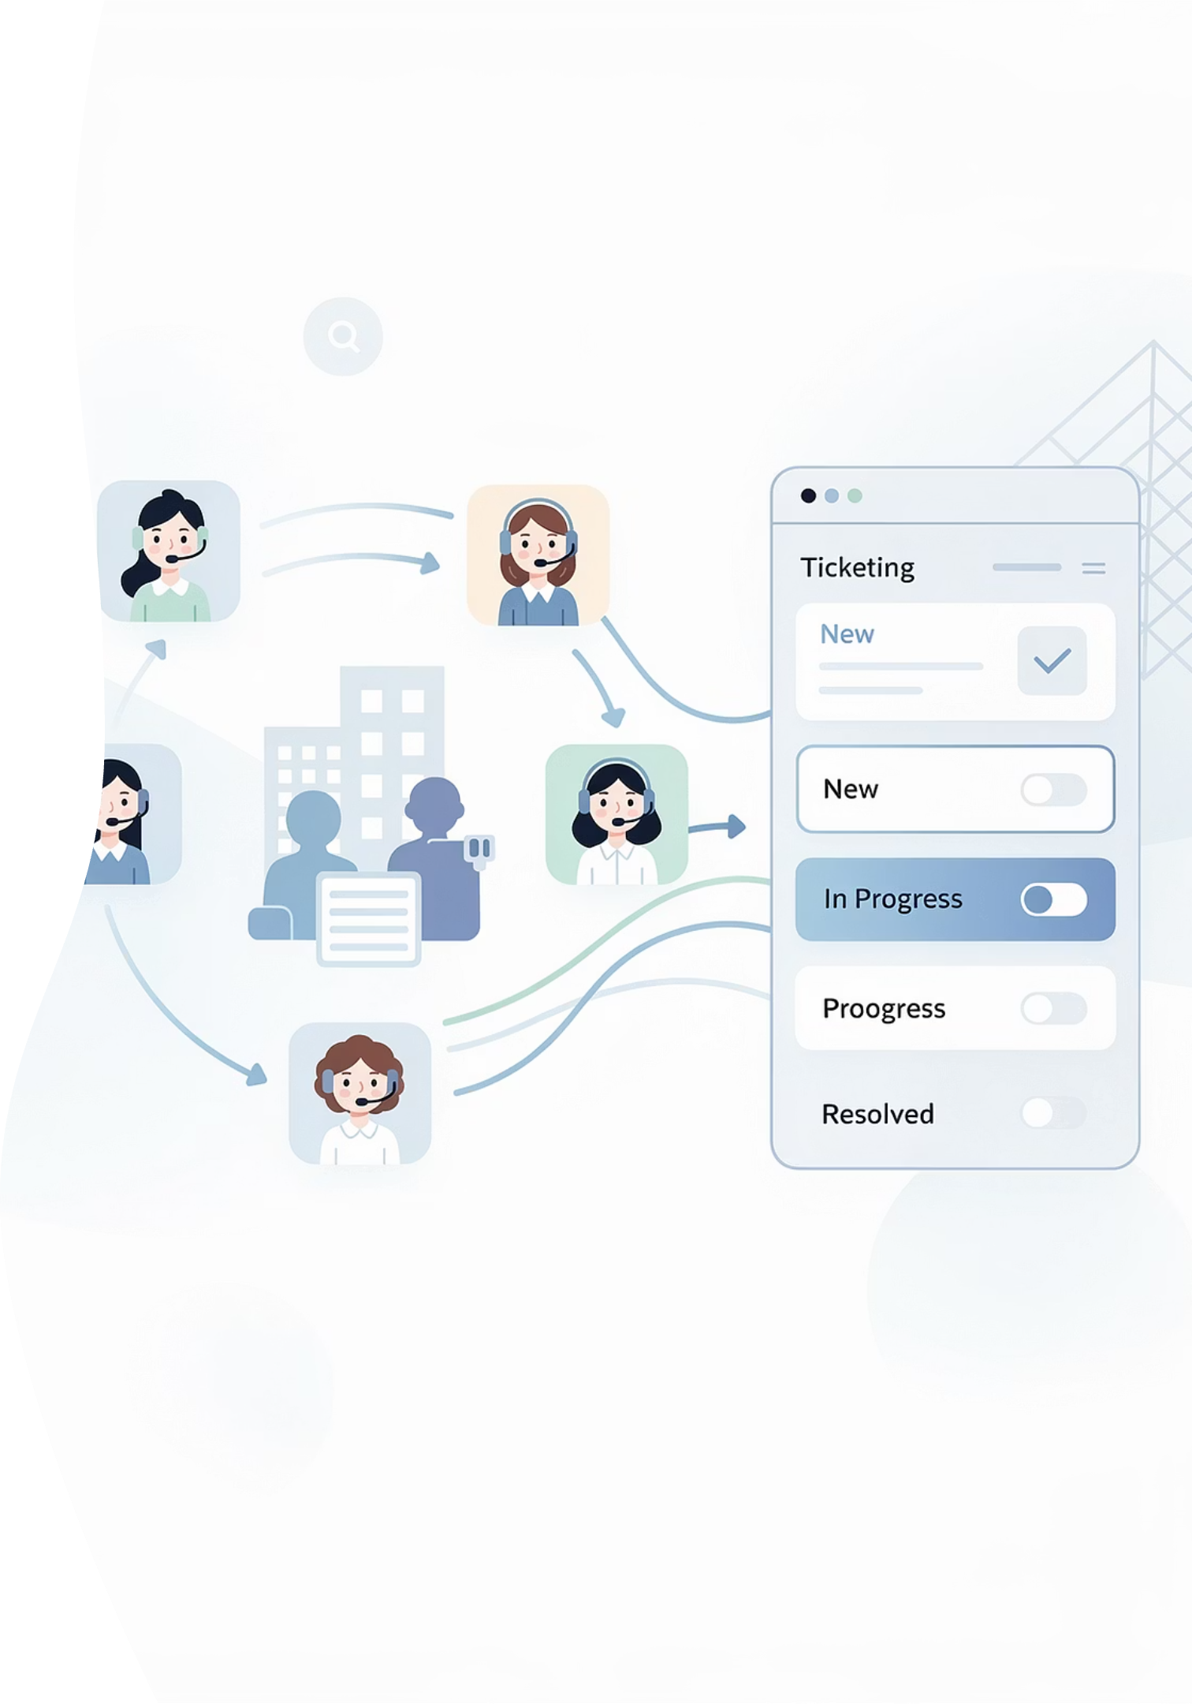
Planning & Requirements Snapshot
Sponsor & Team
Current System
ATSD Ticket Automation team: Patrick Masterson, Hank McAlister, Vedant Sheth, Matt Roehm
Operators often don't create tickets from calls
Manual Jira entry creates chaotic workflow
Impossible to track issues
Sponsored by Appalachian State University IT Services
Missing critical details
High operational friction
New Proposed System
Automated call intake: Webex + Jira integration
Intelligent menu routing
Auto-capture caller data
Record operator info
Auto-generate pre-filled tickets

Slide 7

Business Sponsor
Who They Are
What They Do
Appalachian Technology Service Desk (ATSD) at Appalachian State University
Central IT service desk for entire university community
Password resets & account access
AsULearn platform support
Hardware/software troubleshooting
Route complex issues to specialized queues

Slide 8

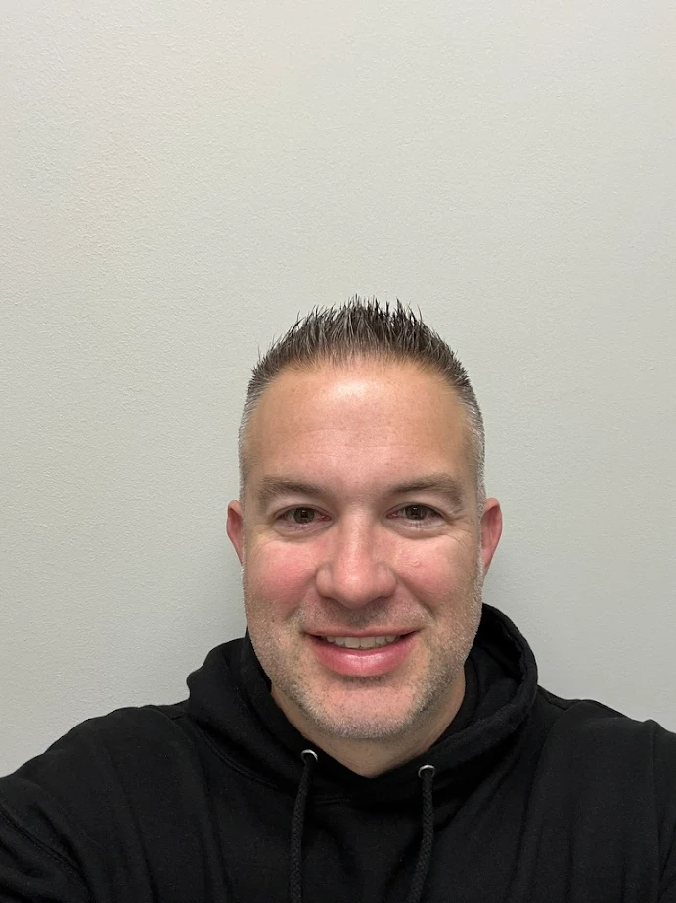
Meet Our Sponsors
Justin Cervero
Choya Durham
Director of IT Systems & Research Computing
ITS Infrastructure Manager
Our project sponsors provide strategic guidance and resources to ensure successful implementation of the ATSD Ticket Automation system. They champion innovation in IT service delivery and support our team's efforts to enhance operational efficiency across the university.

Slide 9
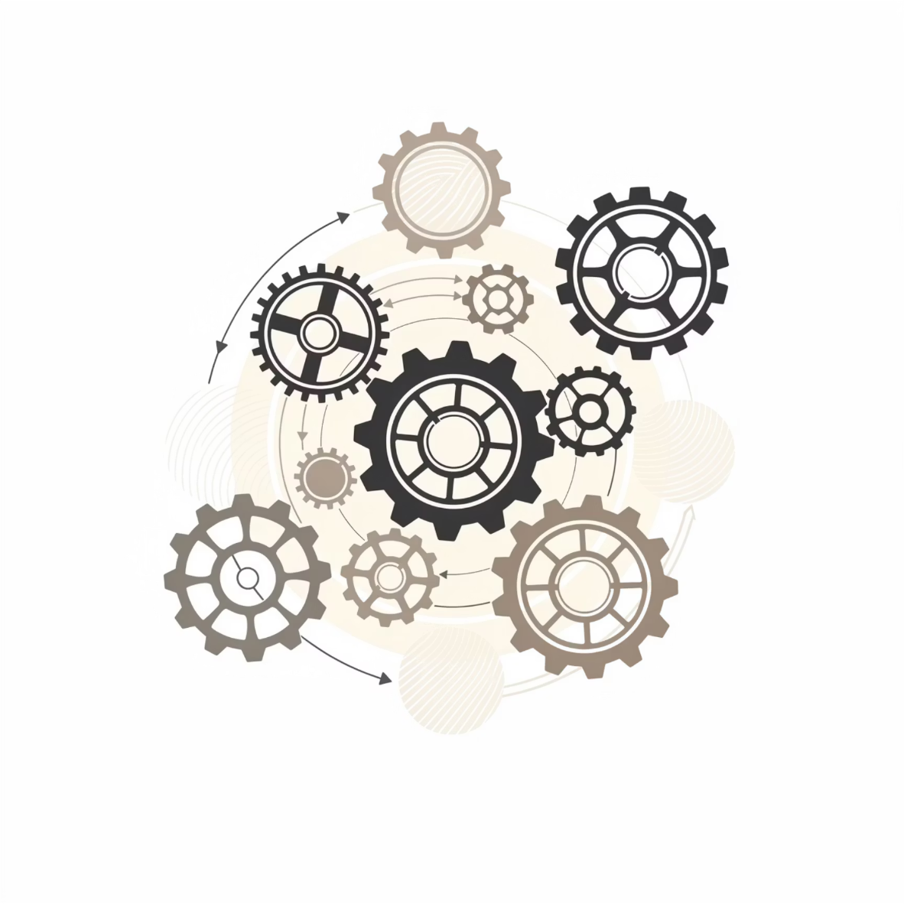

Business Strategy
Value to ATSD
Increased IT service efficiency
Reduced operator workload
Faster turnaround times
Improved user satisfaction
Enhanced accountability & audit trail
Competitive/Strategic Value
Modernizes university IT infrastructure vs. outdated manual processes
Risk Awareness
Competition from universities with advanced IT, seasonal fluctuations, third-party dependencies
Enhanced Support: Better service for students, faculty, staff while strengthening IT reputation

Slide 10
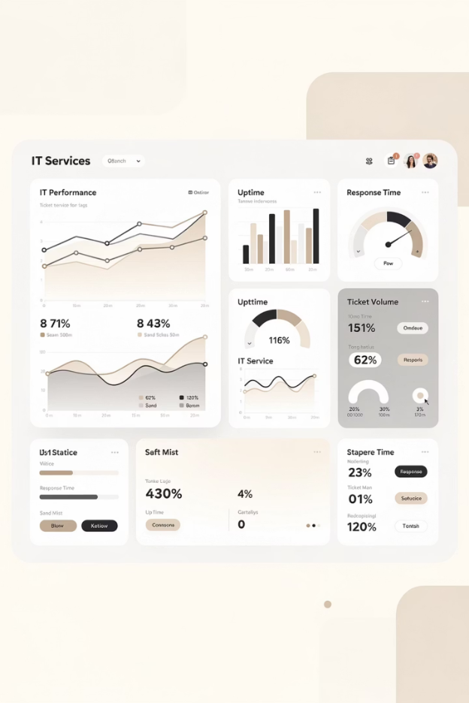



Business Problem: Why It Matters
Performance Measurement
ATSD needs consistent data to measure performance and identify trends
Staffing Justification
Without metrics, difficult to justify staffing levels or request resources
Audit Compliance
Meeting audit expectations requires systematic documentation
Visibility Loss
Without tickets, lose visibility into call volume, recurring problems, service quality
Benefits ATSD Hoped to Gain
Centralized System
Reduced Manual Effort
Enhanced Accountability
Automated system logs calls & creates tickets reliably
Faster support delivery for callers
Better reporting & analytics over time

Slide 11
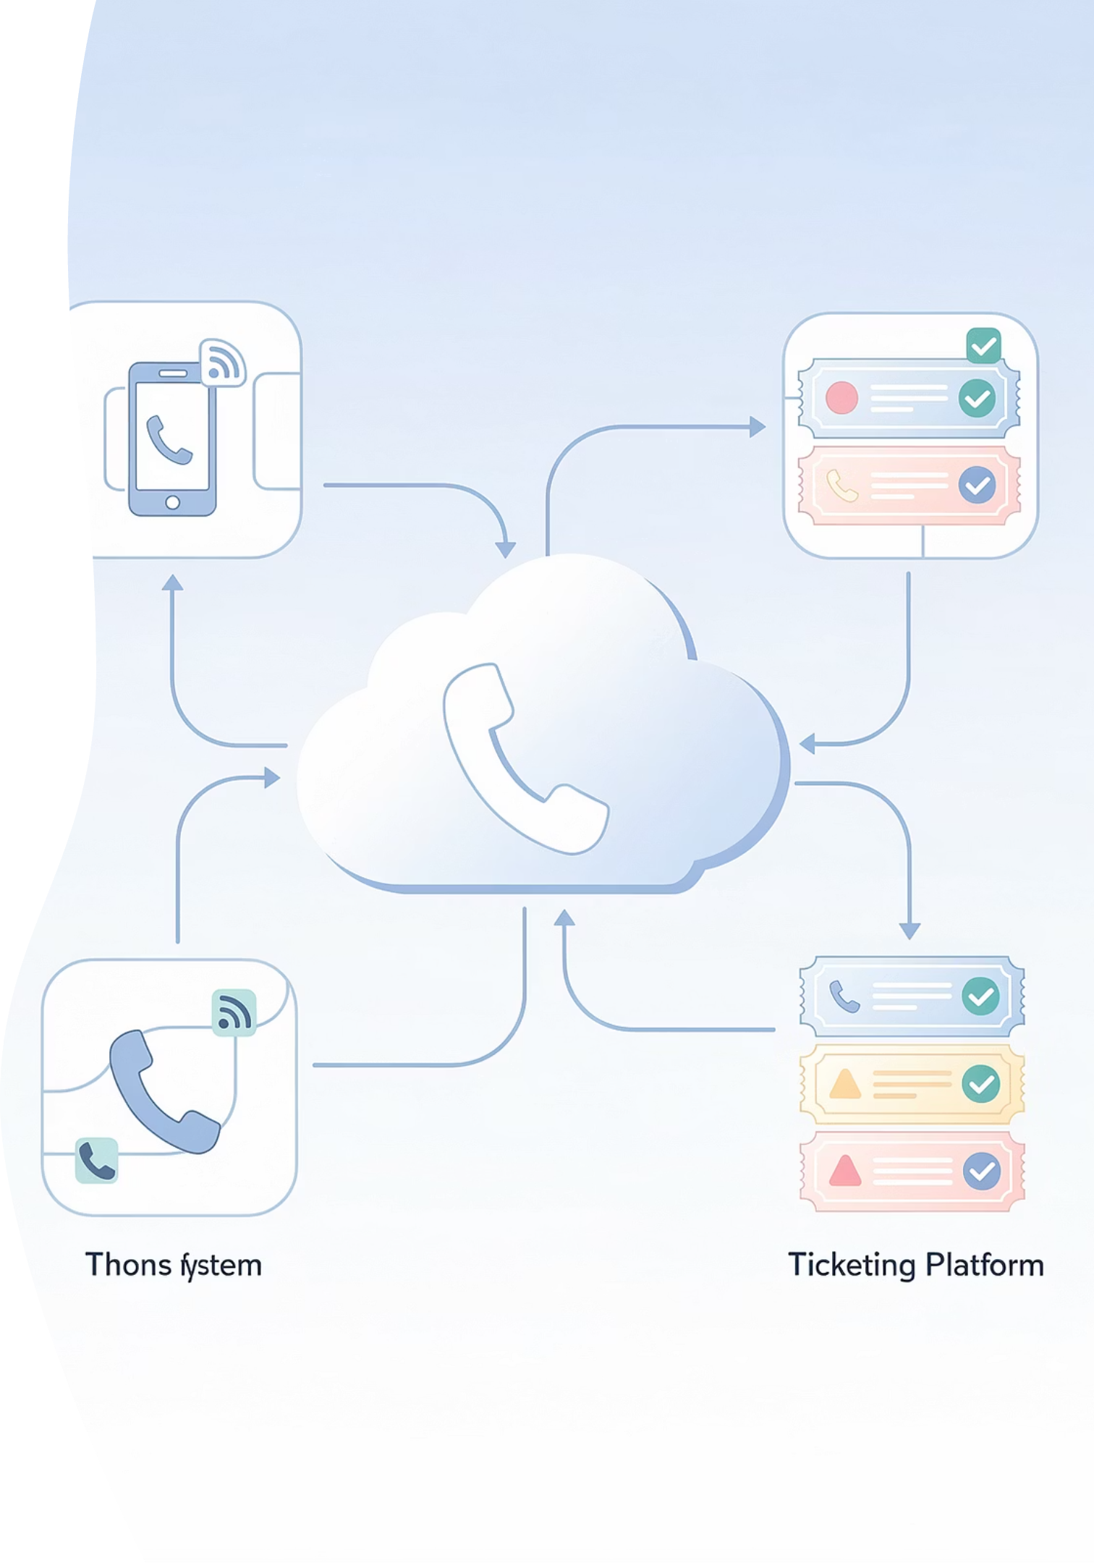



Our Solution: Overview
Webex Call Flow Design
Business hours check
Capture caller phone number
Menu: Password, AsULearn, Help Desk, Tech Support
Route to correct queue
Integration Architecture
Cloudflare Worker as secure middleware
Handles authentication
Data transformation
Jira REST API communication
Automated Ticket Creation
Agent answers → HTTPS request → Worker creates Jira ticket
Ticket ID triggers screen-pop in agent browser

Slide 12
Architecture & Flow
1
2
3
Caller Initiates Contact
Interactive Voice Response Processing
Call Answered Trigger
Caller dials ATSD number, connects through PSTN to Webex Contact Center
Webex Interactive Voice Response performs time check, presents menu, manages queue with hold music/callback
Agent answers → Webex triggers HTTP request to Cloudflare Worker
4
5
Ticket Creation
Agent Desktop Integration
Worker calls Jira REST API
Jira ticket auto-pops in browser via JiraTicketPopUp activity
Project: ATSD
Immediate context for support interaction
Summary: {{issue}}: {{PhoneNumber}}
Assignee: agent email
Queue: technology-help-desk-thd

Slide 13
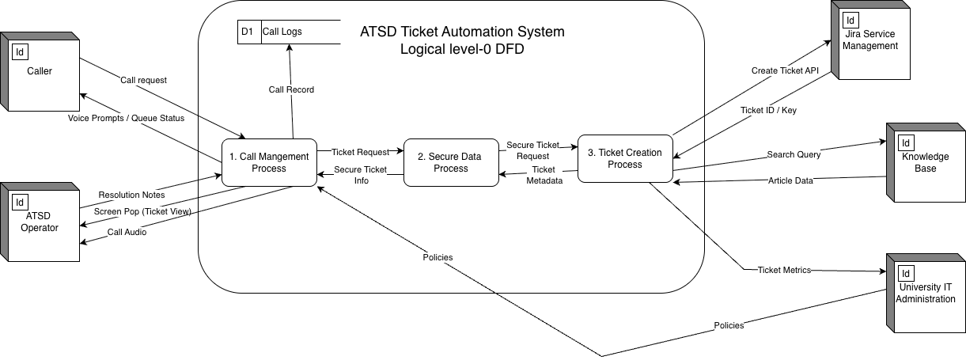
Proposed System: Level 0 Logical

Slide 14
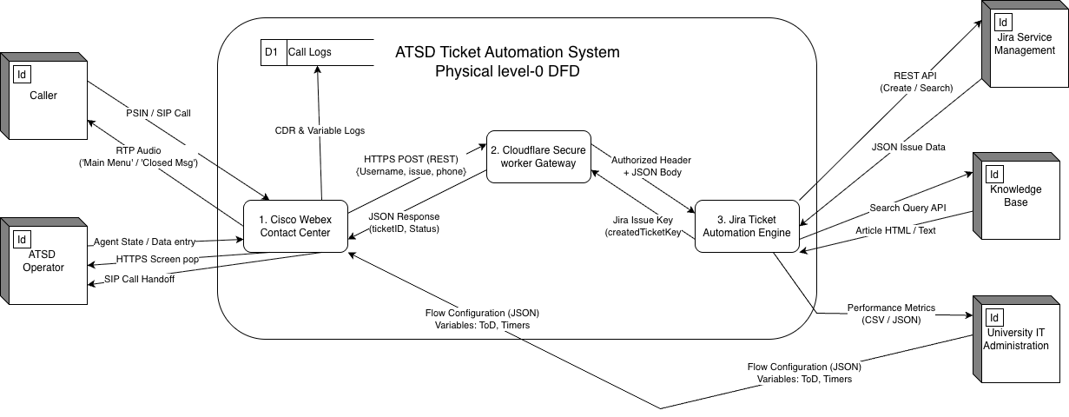
Proposed System: Level 0 Physical

Slide 15
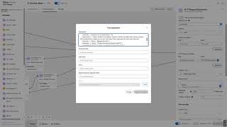
Video Demonstration

Slide 16






Demonstration: User POV
Initial Contact
Caller dials main ATSD number
Hours Check
System plays open/closed message based on business hours
Phone Verification
System confirms or captures caller's phone number
Menu Selection
Press 1: Password Press 2: AsULearn Press 3: Help Desk Press 4: Tech Support
Queue Placement
Enter queue with hold music & callback option
Streamlined, professional experience from the caller's perspective

Slide 17

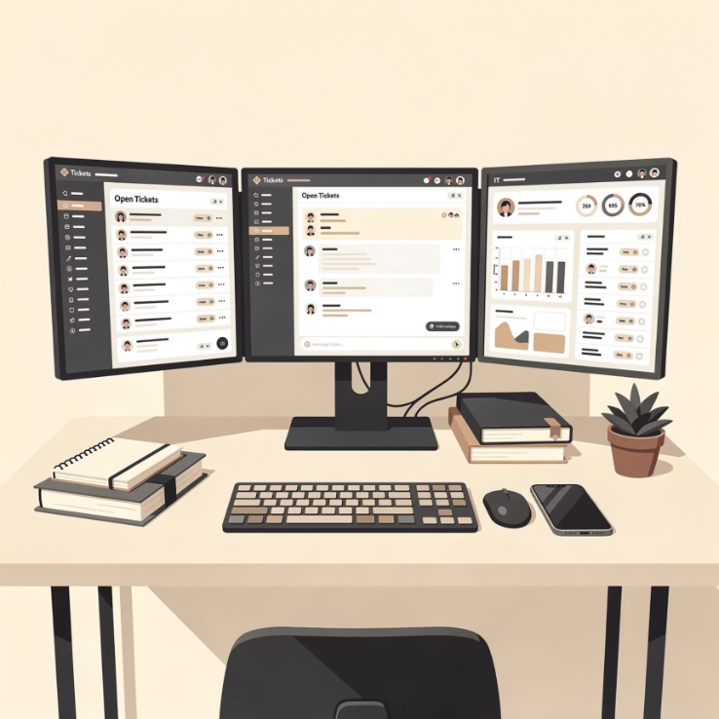
Demonstration: Agent POV
Automated Process
Webex flow invokes HTTP Request activity
Cloudflare Worker sends POST to Jira with all ticket fields
Jira returns newly created ticket ID
Webex triggers JiraTicketPopUp activity
Agent Workflow
Ticket opens in agent's browser
Agents log into Webex agent desktop and join appropriate queues
Agent Actions
Confirm caller details
Add extra notes as needed
When call delivered, automatic ticket creation begins
Work issue using normal Jira workflows

Slide 18
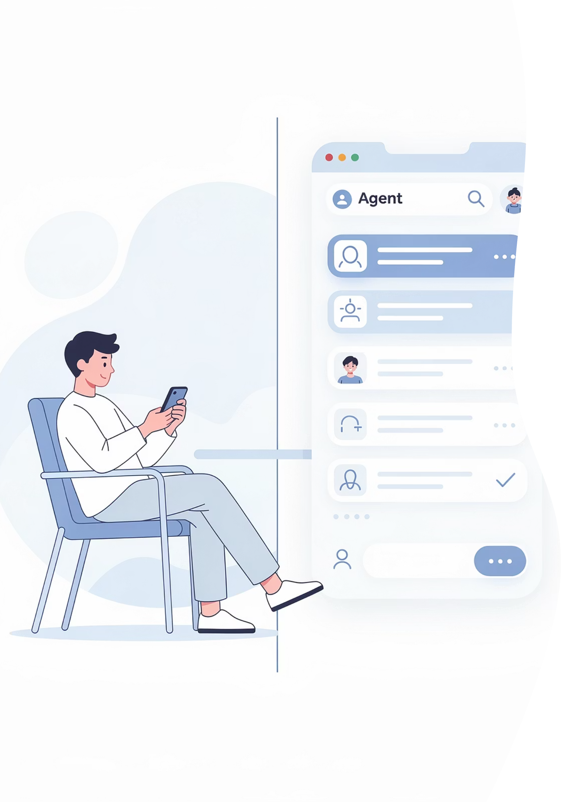
Live Demonstration
User & Agent POV
Complete end-to-end workflow from both perspectives

Slide 19

Summary
Sponsor Reaction
Technical Skills Gained
Sponsors appreciated solution addresses audit gap
Interactive Voice Response & queue logic in Cisco Webex
Enthusiasm for production rollout after testing & licensing
Secure REST integrations with Cloudflare Workers
Formal staging environment testing
Jira REST API implementation
Comprehensive operator training
Production-grade automation workflows
Expansion into analytics & AI routing
Enterprise contact center technology
Project Management Experience
Benefits Delivered
Compressed WBS for tight November-December delivery
For ATSD: Consistent ticket creation, reduced manual effort, foundation for future enhancements (dashboards, AI, multi-channel)
Managed scope change with external constraints: licensing, API limits, access restrictions
Valuable lessons in adaptability & stakeholder communication
For Team: Real-world integration project experience, strong portfolio piece in systems analysis & design

Slide 20

Questions?
Thank you for your attention

